Slide 1
Carbon Cycle
iDiagram Activity
Diagram created by SLSS Teacher Design Team

Slide 2
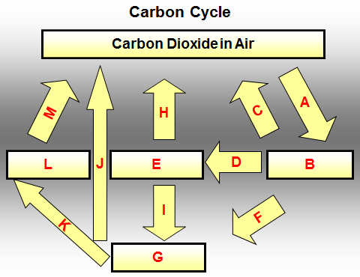
Name the process A in plants that requires CO₂
Animal Carbohydrate
Combustion
Dead Organic Matter
Death and Decay
Eaten
Fossil Fuels
Plant Carbohydrate
Respiration by Microorganisms
Photosynthesis
Respiration
Under certain conditions

Slide 3
CONGRATULATIONS
Please CLICK on
THIS BOX
for the Next Question

Slide 4
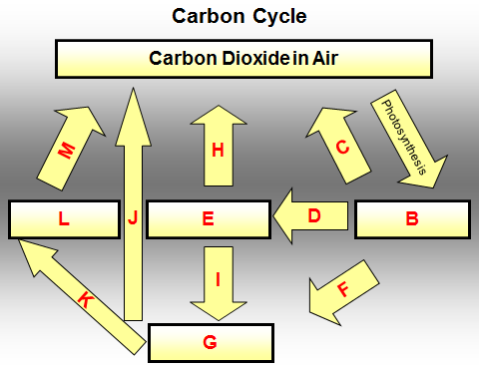
Photosynthesis converts CO₂ into B
Animal Carbohydrate
Combustion
Dead Organic Matter
Death and Decay
Eaten
Fossil Fuels
Plant Carbohydrate
Respiration by Microorganisms
Photosynthesis
Respiration
Under certain conditions

Slide 5
CONGRATULATIONS
Please CLICK on
THIS BOX
for the Next Question

Slide 6
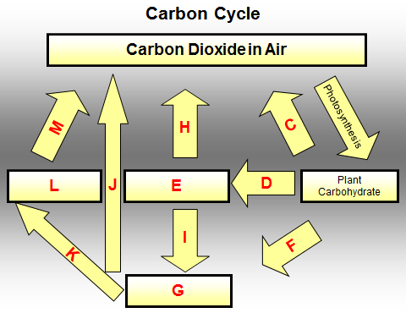
Name the process C in plants that produces CO₂
Animal Carbohydrate
Combustion
Dead Organic Matter
Death and Decay
Eaten
Fossil Fuels
Plant Carbohydrate
Respiration by Microorganisms
Photosynthesis
Respiration
Under certain conditions

Slide 7
CONGRATULATIONS
Please CLICK on
THIS BOX
for the Next Question

Slide 8
Plant carbohydrate can be D by animals
Animal Carbohydrate
Combustion
Dead Organic Matter
Death and Decay
Eaten
Fossil Fuels
Plant Carbohydrate
Respiration by Microorganisms
Photosynthesis
Respiration
Under certain conditions

Slide 9
CONGRATULATIONS
Please CLICK on
THIS BOX
for the Next Question

Slide 10
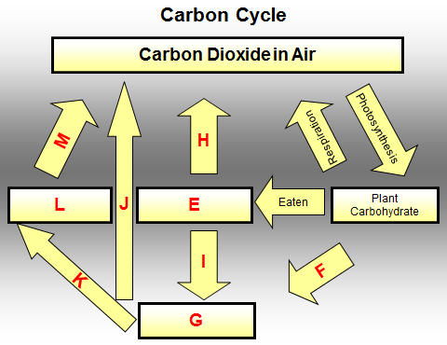
Plant carbohydrate is converted into E
Animal Carbohydrate
Combustion
Dead Organic Matter
Death and Decay
Eaten
Fossil Fuels
Plant Carbohydrate
Respiration by Microorganisms
Photosynthesis
Respiration
Under certain conditions

Slide 11
CONGRATULATIONS
Please CLICK on
THIS BOX
for the Next Question

Slide 12
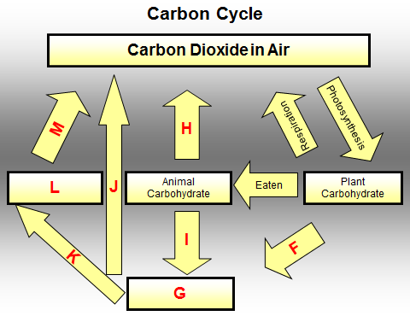
Plant carbohydrate that is not eaten will eventually succumb to F
Animal Carbohydrate
Combustion
Dead Organic Matter
Death and Decay
Eaten
Fossil Fuels
Plant Carbohydrate
Respiration by Microorganisms
Photosynthesis
Respiration
Under certain conditions

Slide 13
CONGRATULATIONS
Please CLICK on
THIS BOX
for the Next Question

Slide 14
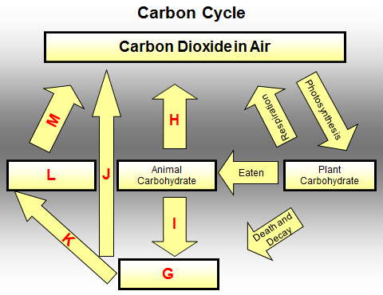
G is formed from dead plants and animals
Animal Carbohydrate
Combustion
Dead Organic Matter
Death and Decay
Eaten
Fossil Fuels
Plant Carbohydrate
Respiration by Microorganisms
Photosynthesis
Respiration
Under certain conditions

Slide 15
CONGRATULATIONS
Please CLICK on
THIS BOX
for the Next Question

Slide 16
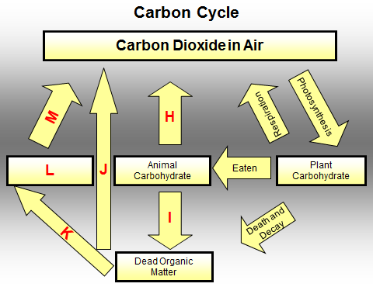
Name the process H in animals that produces CO₂
Animal Carbohydrate
Combustion
Dead Organic Matter
Death and Decay
Eaten
Fossil Fuels
Plant Carbohydrate
Respiration by Microorganisms
Photosynthesis
Respiration
Under certain conditions

Slide 17
CONGRATULATIONS
Please CLICK on
THIS BOX
for the Next Question

Slide 18
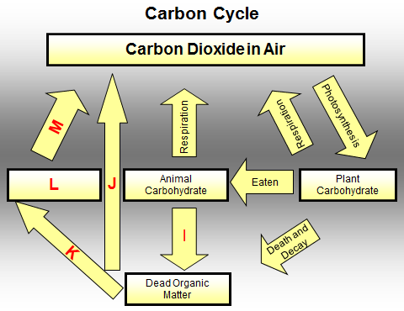
Animal carbohydrate that is not eaten will eventually succumb to I
Animal Carbohydrate
Combustion
Dead Organic Matter
Death and Decay
Eaten
Fossil Fuels
Plant Carbohydrate
Respiration by Microorganisms
Photosynthesis
Respiration
Under certain conditions

Slide 19
CONGRATULATIONS
Please CLICK on
THIS BOX
for the Next Question

Slide 20
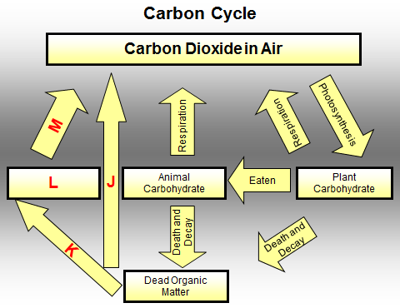
J How carbon dioxide is produced from dead organic matter?
Animal Carbohydrate
Combustion
Dead Organic Matter
Death and Decay
Eaten
Fossil Fuels
Plant Carbohydrate
Respiration by Microorganisms
Photosynthesis
Respiration
Under certain conditions

Slide 21
CONGRATULATIONS
Please CLICK on
THIS BOX
for the Next Question

Slide 22
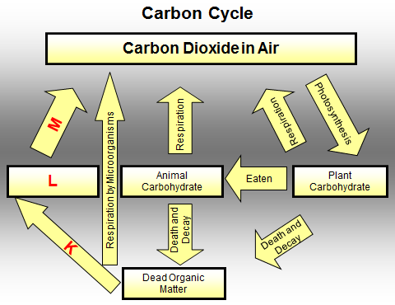
K When can dead organic matter not decay?
Animal Carbohydrate
Combustion
Dead Organic Matter
Death and Decay
Eaten
Fossil Fuels
Plant Carbohydrate
Respiration by Microorganisms
Photosynthesis
Respiration
Under certain conditions

Slide 23
CONGRATULATIONS
Please CLICK on
THIS BOX
for the Next Question

Slide 24
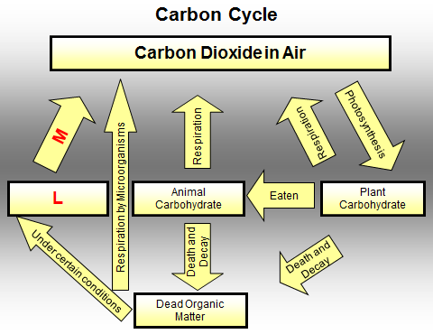
Under certain conditions dead organic matter is converted to L
Animal Carbohydrate
Combustion
Dead Organic Matter
Death and Decay
Eaten
Fossil Fuels
Plant Carbohydrate
Respiration by Microorganisms
Photosynthesis
Respiration
Under certain conditions

Slide 25
CONGRATULATIONS
Please CLICK on
THIS BOX
for the Next Question

Slide 26
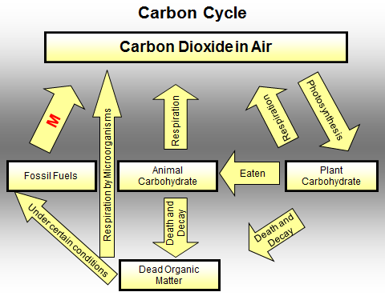
Name the process M that produces CO₂
Animal Carbohydrate
Combustion
Dead Organic Matter
Death and Decay
Eaten
Fossil Fuels
Plant Carbohydrate
Respiration by Microorganisms
Photosynthesis
Respiration
Under certain conditions

Slide 27
CONGRATULATIONS
Please CLICK on
THIS BOX
for the Next Question

Slide 28
Carbon Cycle
Carbon Dioxide in Air
Respiration by Microorganisms
Photosynthesis
Combustion
Respiration
Respiration
Eaten
Fossil Fuels
Animal
Carbohydrate
Plant
Carbohydrate
Under certain conditions
Death and Decay
Death and Decay
Dead Organic
Matter
CLICK HERE

Slide 29
CONGRATULATIONS You’re Brilliant
Click on this box to REPEAT this activity or press ESC to quit

Slide 30
Incorrect
Please CLICK on
THIS BOX
to Try Again

