Slide 1
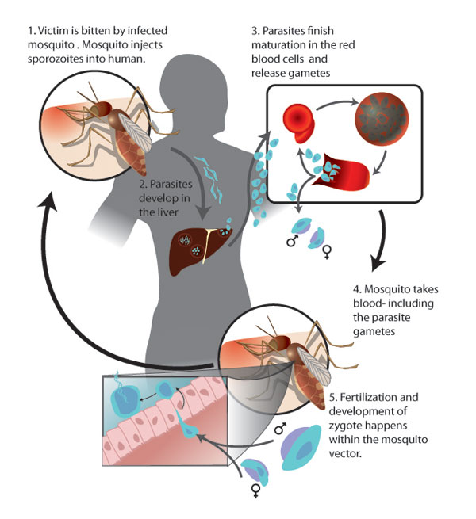
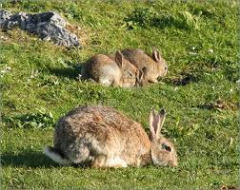
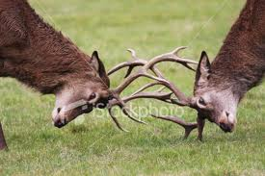
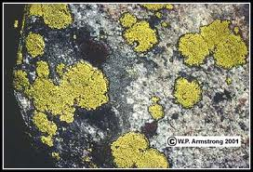
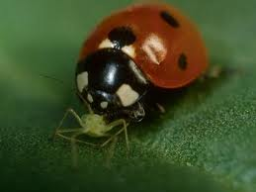
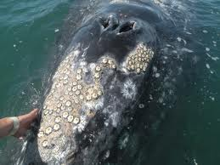
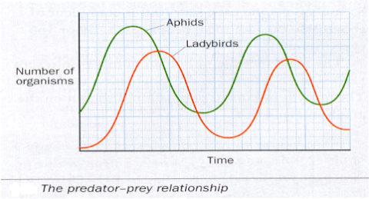
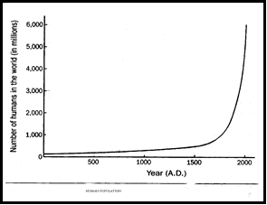
Ecological
relationships
Competition:The struggle for resources that are in limited supply
Mutualism:A relationship between two species in which both benefit
Example: Lichen
A lichen consists of a fungus and alga.
The alga provides food – photosynthesis
The fungus provides shelter
Both benefit!
Scramble: Each gets some of resource
Contest: Winner takes all
Adaptive technique to avoid competition
Live in different geographic areas – don’t meet don’t compete
Parasitism: A relationship between 2 species in which one lives in or on another causing it harm e.g. Mosquito and humans
One benefits, one harmed
Predation: One animal kills and eats another (prey) e.g. ladybird and greenfly
Symbiosis: a relationship between 2 species in which at least one benefits
Factors which control populations:
Competition
Predation
Parasitism
Symbiosis
Commencialism:A relationship between 2 species in which one benefits other not harmed
e.g. Barnacles on whales.
Barnacles attach to the surface of a whale. Barnacles benefit by having a place to stay.
One benefits, other not harmed.
Population Dynamics
The predator curve
follows closely the pattern of the prey but its lags behind as time is needed for the changes to take effect.
The effect on the human population of:
War: decreases
Famine: decreases
Contraception: decreases
Disease: decreases
Adaptive techniques (prey)
Speed – long legs.
Good hearing
Warning colouration
Camouflage
Adaptive techniques predator
Keen eyesight, hearing, sense of smell and dentition suitable to killing prey.
Camouflage, which allows the predator to be concealed while hunting its prey.
Living in groups or packs may help locate food and make prey easier to catch.
Contributory factors:
Food availability, concealment, move to new area
Keywords: Competition, Predation, Parasitism, Symbiosis, Commencialism, Mutualism,

